Slide 1

Atomique
QuEra Challenge - David, Dmitrii, Kevin, Paarth, Quinn

Slide 2
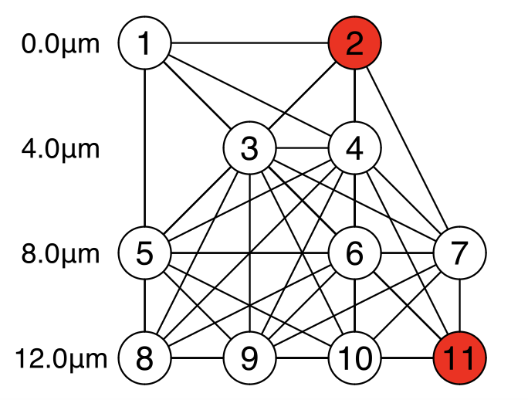
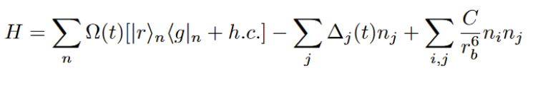
Problem Statement
QuEra Challenge

Slide 3
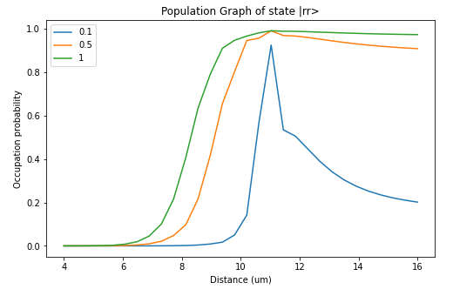
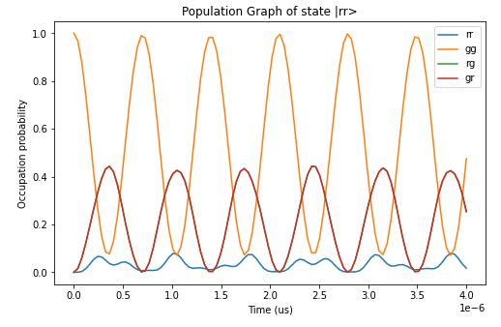
QuTIP Simulation
QuEra Challenge

Slide 4
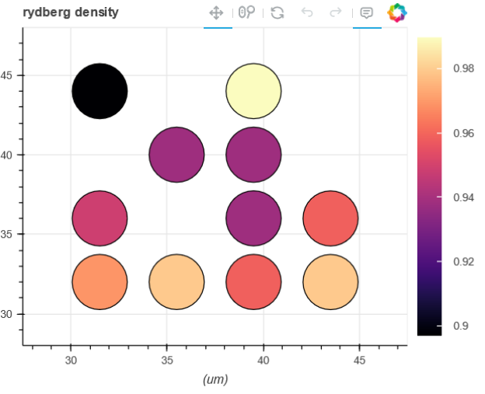
Emulator + Hardware
QuEra Challenge

Slide 5
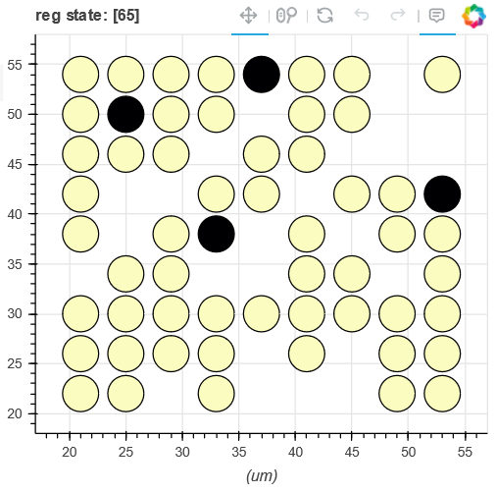
Emulator + Hardware
QuEra Challenge

Slide 6
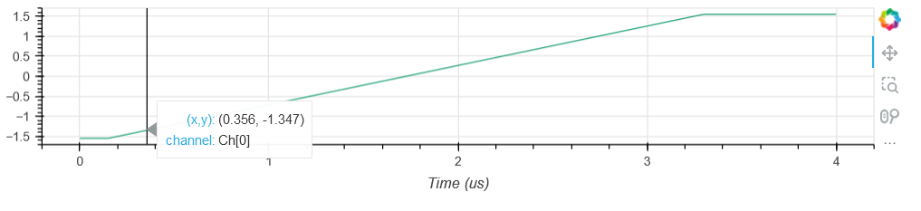
Emulator + Hardware
QuEra Challenge

Slide 7
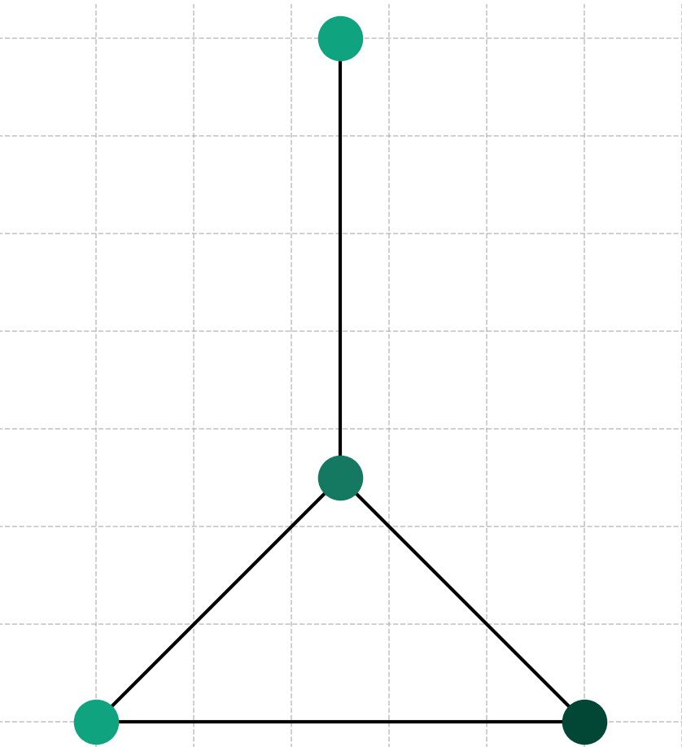
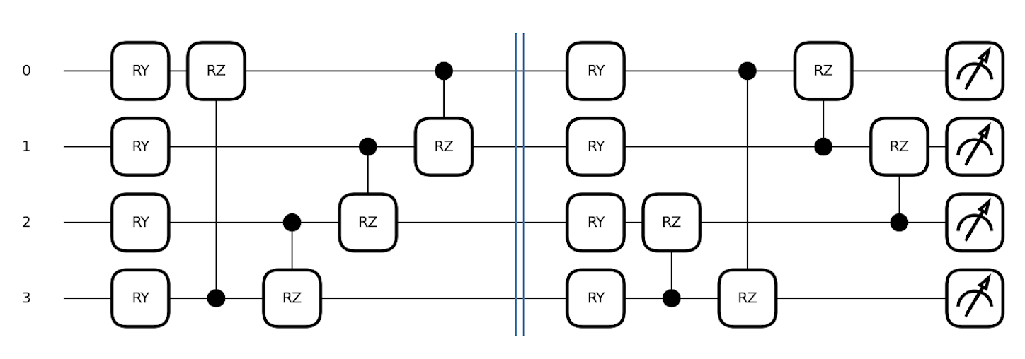
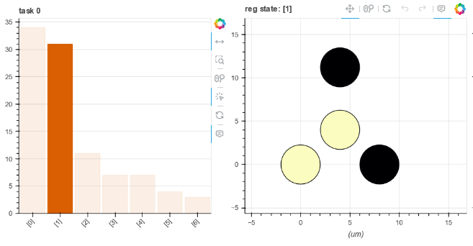
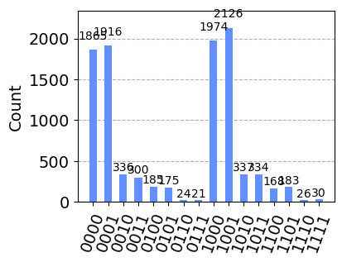
Annealing vs. Circuit Based
Results from Aquila
QuEra Challenge

Slide 8
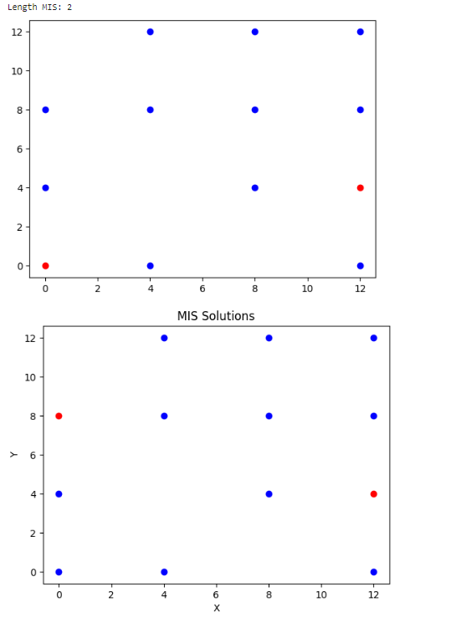
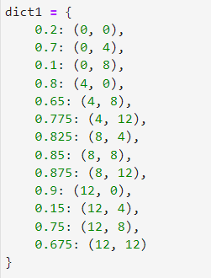
Post Processing
QuEra Challenge

Slide 9
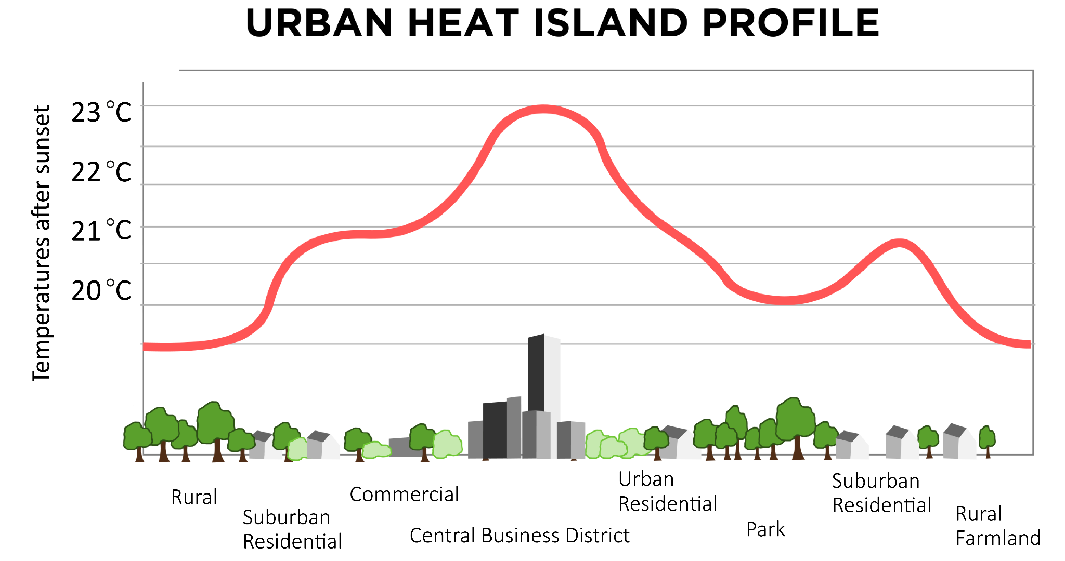
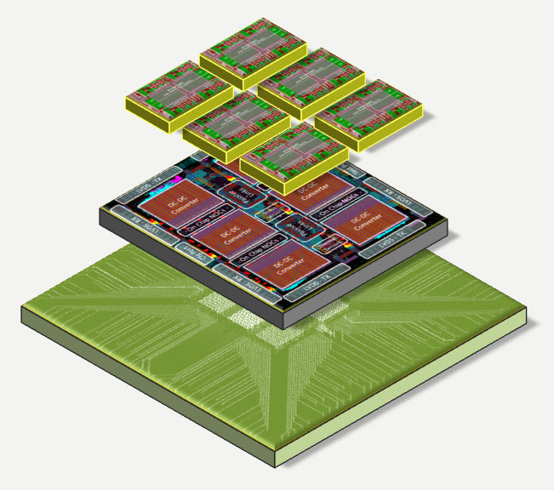
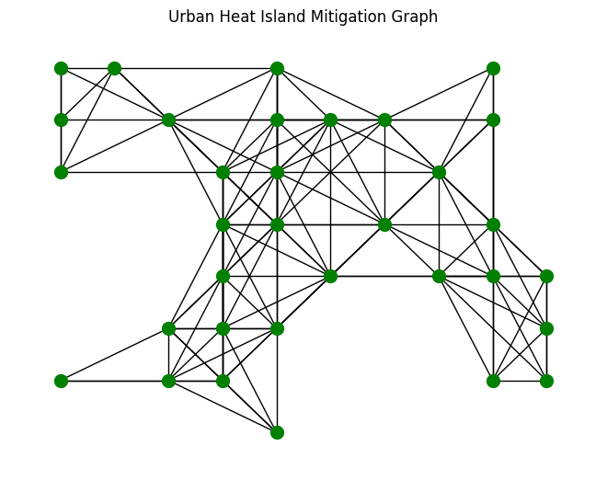
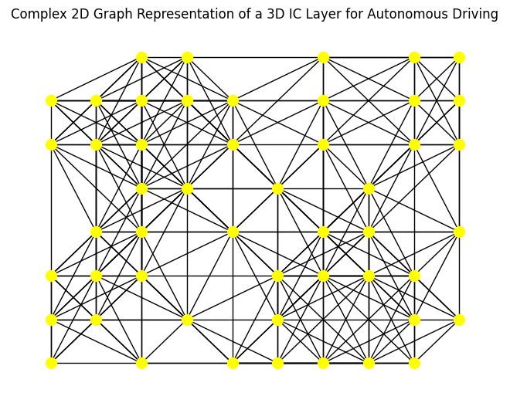
Applications
3D IC Heat Control
Urban Heat Mitigation
QuEra Challenge

